Slide 1


Slide 2
Welcome Southeast Alaska Conference
Align yourself with People who are smarter than You!
Work with Industry Partners
Be Bold, do things differently
Stay close to home for largest ROI
Transportation, Transportation, Transportation
Grab more $$ from existing visitors
Get More Social

Slide 3
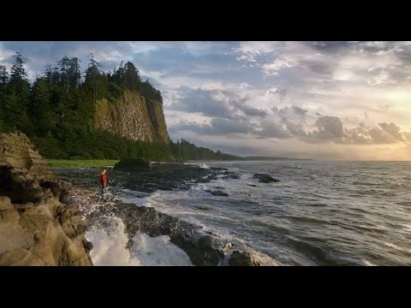
Notes:
+Em

Slide 4
Welcome Southeast Alaska Conference
Align yourself with People who are smarter than You!
Work with Industry Partners
Be Bold, do things differently
Stay close to home for largest ROI
Transportation, Transportation, Transportation
Grab more $$ from existing visitors
Get more Social

