Slide 1

Southeast Conference March 8, 2011

Slide 2
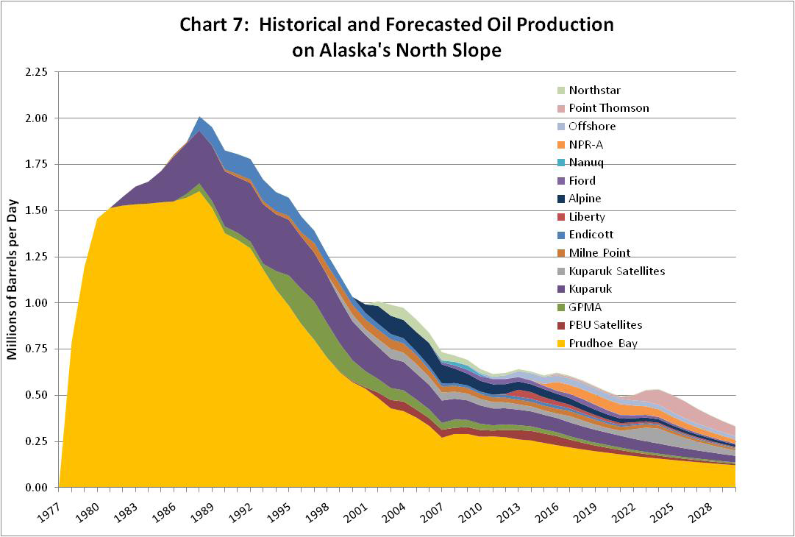

Slide 3
State’s Oil Production Forecast

Slide 4
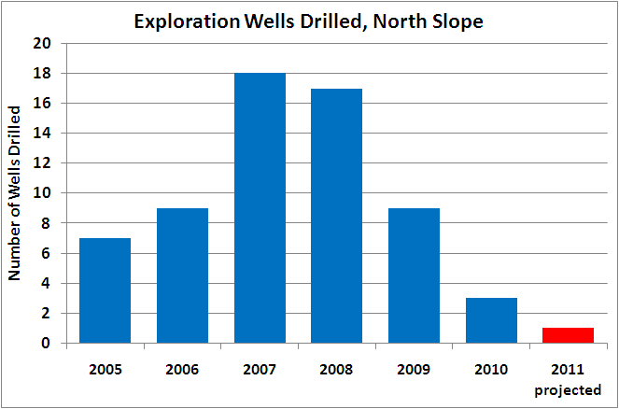
North Slope Exploration Wells

